Slide 1
Research Methodology M.Sc. Degree 2021-2022 Prof.Dr. Abbas H. Alasadi Email : abbashh2002@gmail.com University of Basrah College of Information Technology Computer Information System Department
Lecture 2

Slide 2
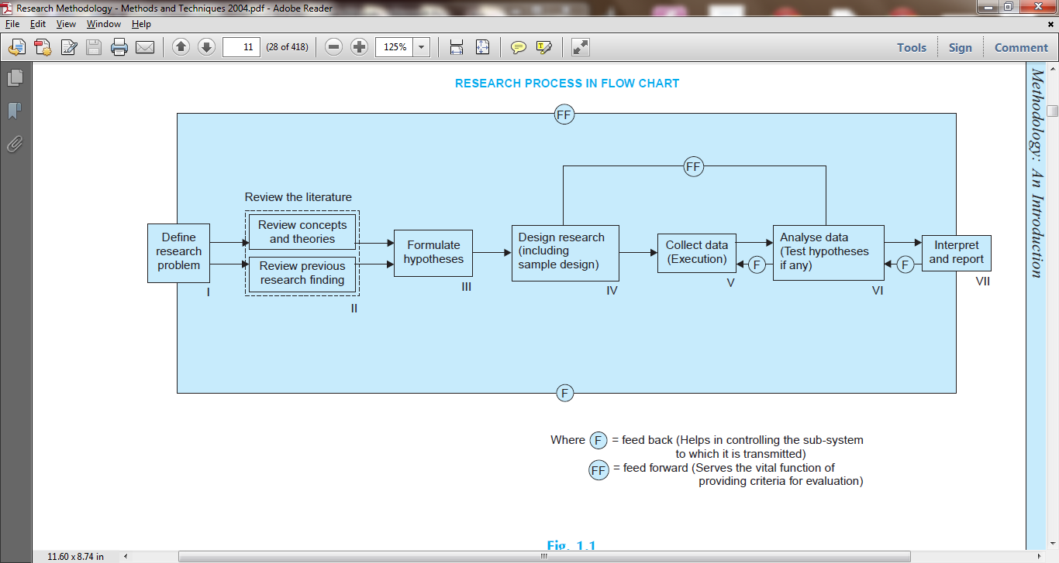
Research Process Guideline

Slide 3
Research Process Guideline
formulating the research problem;
extensive literature survey;
developing the hypothesis;
preparing the research design;
determining sample design;
collecting the data;
execution of the project;
analysis of data;
hypothesis testing;
generalizations and interpretation,
preparation of the report or presentation of the results ,i. e., formal write-up of conclusions reached.

Slide 4
Research Process Guideline
formulating the research problem;
There are two types of research problems, viz., those which relate to states of nature and those which relate to relationships between variables.
extensive literature survey;
Once the problem is formulated, a brief summary of it should be written down. It is compulsory for a research worker writing a thesis for a Ph.D. degree to write a synopsis of the topic and submit it to the necessary Committee or the Research Board for approval.
developing the hypothesis;
After extensive literature survey, researcher should state in clear terms the working hypothesis or hypotheses.
Working hypothesis is tentative assumption made in order to draw out and test its logical or empirical consequences.

Slide 5
RESEARCH PROCESS GUIDELINE
preparing the research design;
The research problem having been formulated in clear cut terms, the researcher will be required to prepare a research design, i.e., he will have to state the conceptual structure within which research would be conducted.
Research purposes may be grouped into four categories, viz., (i) Exploration, (ii) Description, (iii) Diagnosis, and (iv) Experimentation.
There are several research designs, such as, experimental and non-experimental hypothesis testing.
Experimental designs can be either
Informal designs (such as before-and-after without control, after-only with control, before-and-after with control)
Formal designs (such as completely randomized design, randomized block design, Latin square design, simple and complex factorial designs), out of which the researcher must select one for his own project.

Slide 6
RESEARCH PROCESS GUIDELINE
determining sample design;
All the items under consideration in any field of inquiry constitute a ‘universe’ or ‘population’.
A complete enumeration of all the items in the ‘population’ is known as a census inquiry.
A brief mention of the important sample designs is as follows:
Deliberate sampling: Deliberate sampling is also known as purposive or non-probability sampling.
Simple random sampling: This type of sampling is also known as chance sampling or probability sampling where each and every item in the population has an equal chance of inclusion in the sample and each one of the possible samples, in case of finite universe, has the same probability of being selected.
Systematic sampling: In some instances the most practical way of sampling is to select every 15th name on a list, every 10th house on one side of a street and so on.

Slide 7
RESEARCH PROCESS GUIDELINE
Stratified sampling: If the population from which a sample is to be drawn does not constitute a homogeneous group, then stratified sampling technique is applied so as to obtain a representative sample.
Quota sampling: In stratified sampling the cost of taking random samples from individual strata is often so expensive that interviewers are simply given quota to be filled from different strata, the actual selection of items for sample being left to the interviewer’s judgment.
Multi-stage sampling: This is a further development of the idea of cluster sampling.
Sequential sampling: This is somewhat a complex sample design where the ultimate size of the sample is not fixed in advance but is determined according to mathematical decisions on the basis of information yielded as survey progresses.

Slide 8
Research Process Guideline
collecting the data;
Data can be collected by any one or more of the following ways:
By observation
Through personal interview
Through telephone interviews
By mailing of questionnaires
Through schedules
execution of the project;
Execution of the project is a very important step in the research process.
The researcher should see that the project is executed in a systematic manner and in time.

Slide 9
Research Process Guideline
analysis of data;
Requires a number of closely related operations such as establishment of :
Categories
Coding
Editing
Tabulation
Analysis work after tabulation is generally based on the computation of various percentages, coefficients, etc., by applying various well defined statistical formulae.
hypothesis testing;
Various tests, such as Chi square test, t-test, F-test, have been developed by statisticians for the purpose.
Hypothesis-testing will result in either accepting the hypothesis or in rejecting it.

Slide 10
Research Process Guideline
generalizations and interpretation,
If a hypothesis is tested and upheld several times, it may
be possible for the researcher to arrive at generalization, i.e., to build a theory.
As a matter of fact, the real value of research lies in its ability to arrive at certain generalizations.
If the researcher had no hypothesis to start with, he might seek to explain his findings on the basis of some theory.
It is known as interpretation. The process of interpretation may quite often trigger off new questions which in turn may lead to further researches.

Slide 11
RESEARCH PROCESS GUIDELINE
preparation of the report or presentation of the results
Finally, the researcher has to prepare the report of what has been done by him.
Writing of report must be done with great care keeping in view the following:
The layout of the report should be as follows:
the preliminary pages;
the main text, and
the end matter. In its preliminary pages the report should carry title and date followed by acknowledgements and foreword. Then there should be a table of contents followed by a list of tables and list of graphs and charts, if any, given in the report.

Slide 12
RESEARCH PROCESS GUIDELINE
preparation of the report or presentation of the results
The main text of the report should have the following parts:
Introduction: It should contain a clear statement of the objective of the research and
an explanation of the methodology adopted in accomplishing the research. The scope
of the study along with various limitations should as well be stated in this part.
Summary of findings: After introduction there would appear a statement of findings and recommendations in non-technical language. If the findings are extensive, they should be summarized.
Main report: The main body of the report should be presented in logical sequence and broken-down into readily identifiable sections.
Conclusion: Towards the end of the main text, researcher should again put down the results of his research clearly and precisely. In fact, it is the final summing up.

